Slide 1
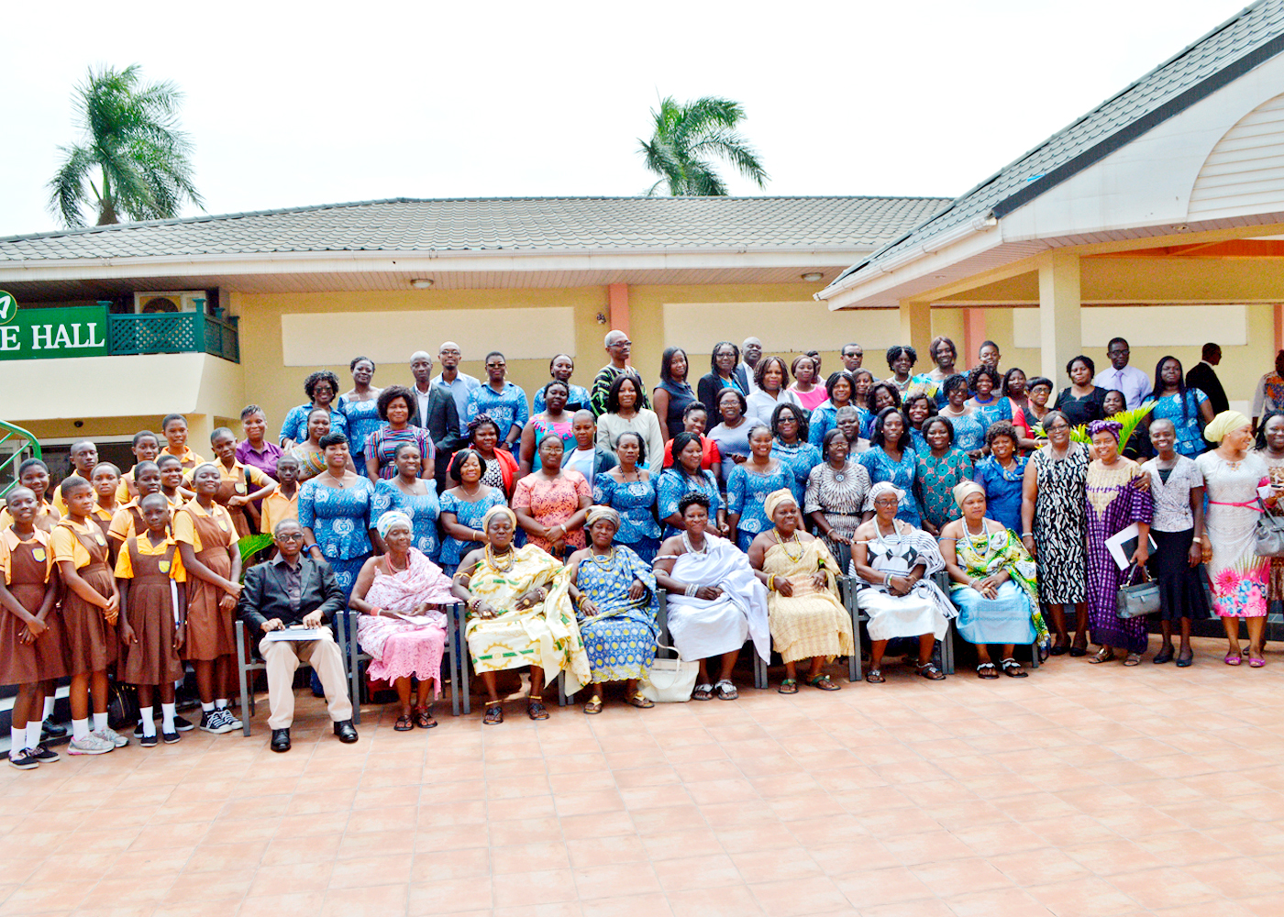
BACKGROUND INFORMATION for the anglophone countries
Women networks working and established in 5 Anglophone countries namely:
Ghana
Malawi
Kenya
Uganda
Nigeria

Slide 2
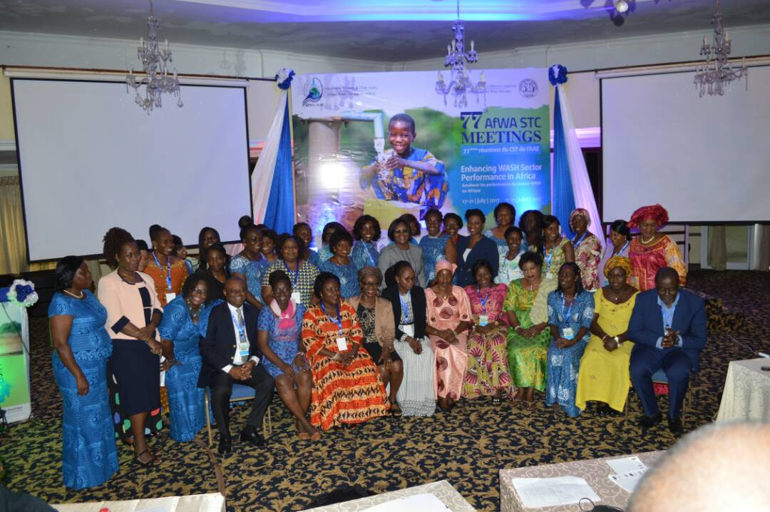
HISTORY OF THE ASSOCIATION
A network of women professionals working in the water and sanitation sector –
Women in WASH; Ghana
Wiwas – Kenya
W4WaSU – Uganda
Network of Women Professionals - Nigeria
Membership:
Ghana: 36 Nigeria: 185 Kenya: 50 Uganda: 67

Slide 3
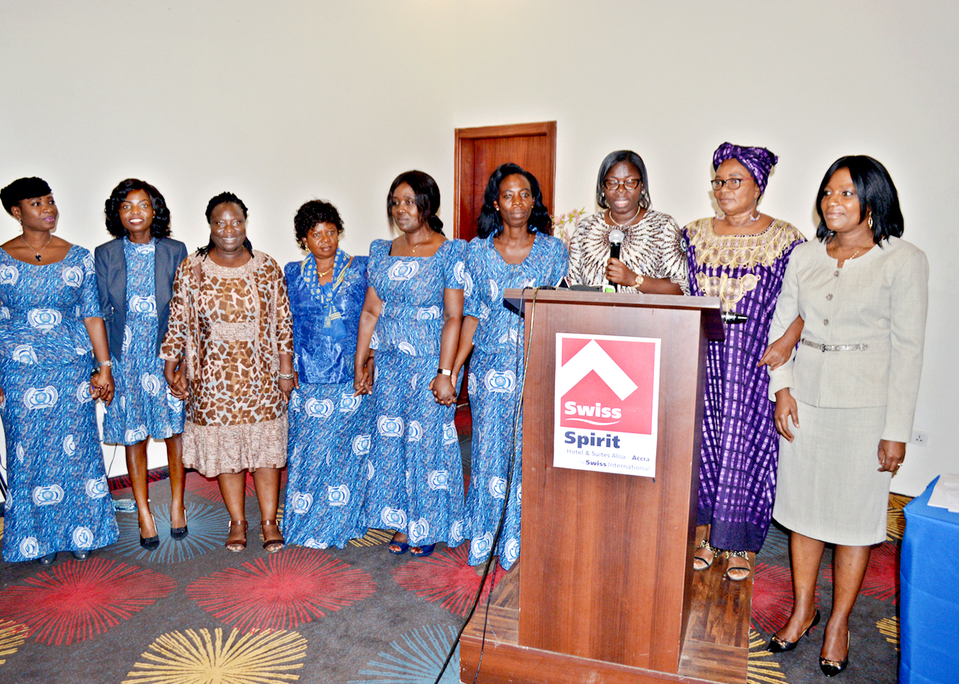
EXECUTIVE MEMBERS - Presidents
GHANA – Faustina Boachie
KENYA - Elizabeth Mwangi
NIGERIA - Barr. Agbo Cordelia Ijeoma
UGANDA – Dr. Rose Kaggwa

Slide 4
I-4 VISION/MISSIONS/OBJECTIFS - OBJECTIVES
Vision
The model women’s network in promotion of universal access to water and sanitation – Kenya
Mainstream gender in the WASH sector - Ghana
To provide a platform for coordinating and supporting improved water supply and sanitation service delivery and professional advancement _ Nigeria
To be a leading transformational network that empowers women in water and sanitation - Uganda
Mission
To promote universal access to WASH services for all through empowerment of women, advocacy, innovation, capacity building, networking and community outreach
Objectives
Promote knowledge sharing and experience amongst professional women
Coaching and mentoring for leadership
Policy level engagement
Provide a platform of mentorship for the Young Water professionals and the girl-child

Slide 5
ACTIVITIES
July – November 2017
Sensitization and awareness creation of the need for gender equality and equal opportunity in the WASH sector on-going for all networks
WASH in schools program for about 5 primary schools in Ghana done
Empowering the girl-child_ recognition of the SWAS (schools water and sanitation clubs) girl stars done
Representation & voice in WASH leadership forums ongoing in Kenya
The International Annual General Meeting of the NWSA which is the biggest platform for women in the sector to share knowledge and peer-review activities launched in the state utilities in Nigeria.

Slide 6
ACTION PLAN 2018
Country | Deliverable | Activities | By When
Uganda | Establish the network | Finalise necessary approvals and documents, finalise constitution, elect committee, design brand, etc | January 2018
Ghana, Uganda, Nigeria, Kenya | Membership drive | Awareness creation, embarking on courtesy visits to other state and regional offices | Jan 2018, Uganda Quarterly for others
All | Continous Professional Development | Conduct training and mentorship programs, organise an annual women’s power dialogue to discuss issues of WaTSAN | Jan 2018 Dec 2018
All | Community Outreach & sensitization programs | Carry out WASH outreach programs in conjunction with WaterAid ( Ghana & Nigeria) WASH outreach with SWA Clubs and YWPs (Uganda) | Jan 2018 Dec 2018

Slide 7
ACTION PLAN 2018 – Cont’d
Country | Deliverable | Activities | By When
Uganda & Ghana | Mentorship programs for YWP, the girl-child and schools | Carry out quarterly mentorship programs for YWP and primary school children | Jan 2018 Dec 2018
All | Conduct annual general events | Hold AGMs for all networks Participate and contribute towards international women's day, world water day, world toilet day events | Jan 2018 Dec 2018

Slide 8
I-7 PERSPECTIVES/THE WAY FORWARD
Launch of W4WaSU in January 2018
All networks to embark on a membership drive
Operationalise the work plan for 2018
Linkage with other Professional Women's Networks to deepen learning and engagement
Begin to discuss how to raise money to fund activities

Slide 9
OBSERVATIONS – REMARKS – OTHER INFORMATION
Under-representation of women from utilities in the Anglophone countries is worrying
Funding needed to enable the realization of all networks objectives and action plans

