Slide 1


Slide 2

Capacity Building: Innovation and Technology transfer
Session 2
Dr Valerie Naidoo
Water Research Commission

Slide 3


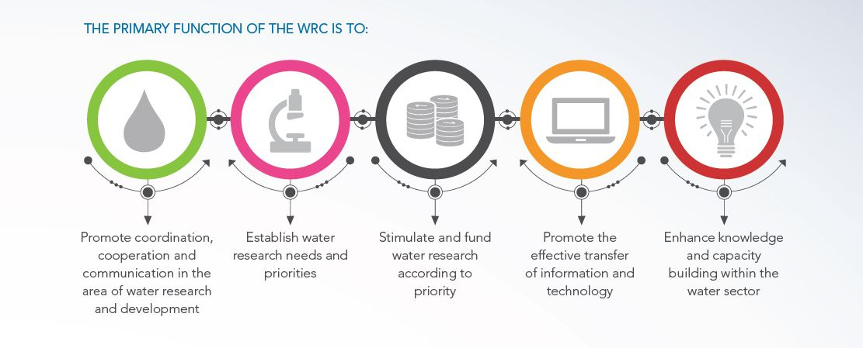




WATER RESEARCH COMMISSION
  Water Research Act (Act No. 34 of 1971 as amended)
  The WRC’s mandate, as set out in this Act, highlights the following functions to be carried out by the organization:
91st MEETING OF THE SCIENTIFIC AND TECHNICAL COUNCIL OF THE
AFRICAN WATER AND SANITATION ASSOCIATION
From AfWA to AfWASA: “What governance and management structures
are required to boost water and sanitation performance in Africa”
3-5 July 2023

Slide 4




DRIVERS: ESTABLISHING NEEDS AND DEMANDS
Aging Infrastructure & Prohibitive cost of New Infrastructure
Population growth and rapid urbanization
Water Scarcity and Stress
Pollution and Water Quality Deterioration
Climate Change
Current sewer and centralized wastewater treatment systems are capacity strained (OVERLOAD)
Infrastructure repairs and refurbishments are costly
Competing needs for limited resources in a low-growth environment
SA has high risk climate
Extreme weather events
Rising seawater levels and temperatures
Frequent Droughts and longer duration of droughts
Frequent and possibly short intense flood patterns on east
Recovery of assets
Half of global population could be facing water shortages by 2030
SA Deficit between water supply and demand could be between 2,7 and 3,8 billion m³/a by 2030,
Water inavailability and unreliability for flushing
Many of the rivers and ecosystems are in critical condition due to effects of pollution
Huge challenges around failing treatment works and stockpiles of sludge
66% of global population projected to be urban in 2050
Settlements continue in unplanned and flood zones
External costs associated with waterborne disease (health)
91st MEETING OF THE SCIENTIFIC AND TECHNICAL COUNCIL OF THE
AFRICAN WATER AND SANITATION ASSOCIATION
From AfWA to AfWASA: “What governance and management structures
are required to boost water and sanitation performance in Africa”
3-5 July 2023

Slide 5

CAPACITY BUILDING
New Skills and Practices
  Research Skills
  Expertise
Transparency
Equity
Social Justice
Future Skills
  4IR (Digital, Machine learning and AI)
91st MEETING OF THE SCIENTIFIC AND TECHNICAL COUNCIL OF THE
AFRICAN WATER AND SANITATION ASSOCIATION
From AfWA to AfWASA: “What governance and management structures
are required to boost water and sanitation performance in Africa”
3-5 July 2023

Slide 6
TECHNOLOGY READINESS FOR UPTAKE
91st MEETING OF THE SCIENTIFIC AND TECHNICAL COUNCIL OF THE
AFRICAN WATER AND SANITATION ASSOCIATION
From AfWA to AfWASA: “What governance and management structures
are required to boost water and sanitation performance in Africa”
3-5 July 2023

Slide 7
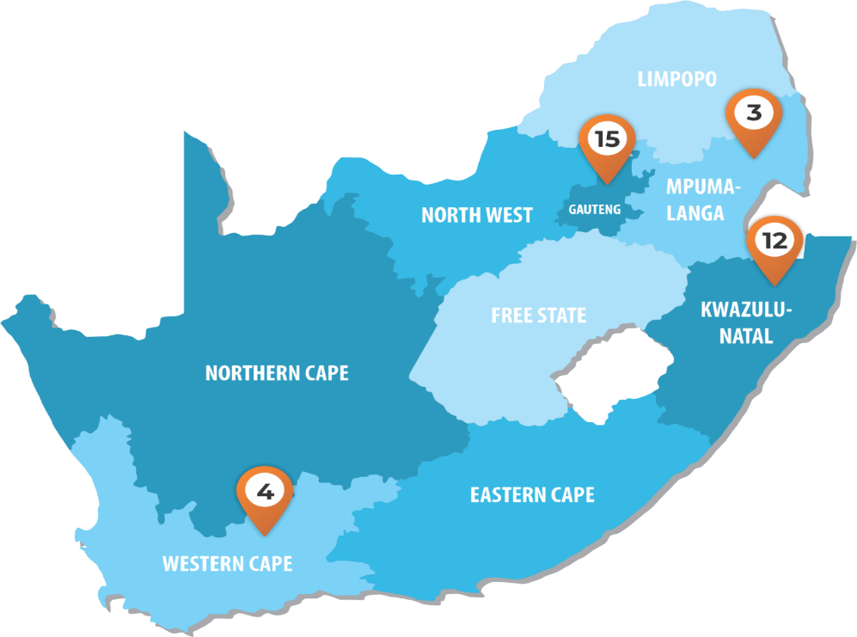
WADER: TECHNOLOGY ACCELERATOR
WATER TECHNOLOGIES DEMONSTRATION PROGRAMME
  Technologies, Processes, Devices, Apps
    Water availability
      Desiltation – vortex settling
    Alternate sources of water
      Sandwater water extraction
    Water Efficiency at household level
      RWH
      Water reserve
    Treatment Processes
      eutectic freeze crystallization
      Solar desalination
    Digital
      Remote training/operations
      Satellite based monitoring and evaluation of pollution/eutrophication
91st MEETING OF THE SCIENTIFIC AND TECHNICAL COUNCIL OF THE
AFRICAN WATER AND SANITATION ASSOCIATION
From AfWA to AfWASA: “What governance and management structures
are required to boost water and sanitation performance in Africa”
3-5 July 2023

Slide 8
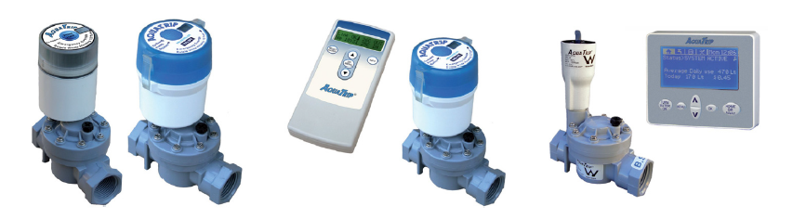
WADER: AQUATRIP (WATER TRIP SWITCH)
The AquaTrip is a patented permanently installed water leak detection system, which monitors the flow of water into a property. In the event of a situation where there is unnecessary water loss, the AquaTrip system will automatically switch off the water and protect the entire plumbing system. It does not alter consumption patterns it only eliminates water wastage and it can be placed anywhere on site and does not require maintenance and/or mains power.
Technology Area
Water Saving Systems/Prevention of continuous
water loss
RDI Cluster
Efficiency/Reducing Losses
Impact (8 sites)
Success rate of 100% - a saving of between 15%-91%.
3,220,000 litres of water saved and R463 680 worth of billing saved.
91st MEETING OF THE SCIENTIFIC AND TECHNICAL COUNCIL OF THE
AFRICAN WATER AND SANITATION ASSOCIATION
From AfWA to AfWASA: “What governance and management structures
are required to boost water and sanitation performance in Africa”
3-5 July 2023

Slide 9
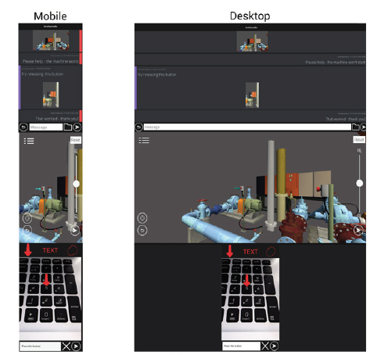
WADER: LOOKSEEDO REMOTE TECHNICIAN
Look See Do’s Remote Technician Tool (RTT) enables a remotely based expert to assist a remotely located field technician to perform maintenance and repairs on equipment, thereby avoiding the requirement of the expert having to travel to site. The aim of the pilot is to provide information and communication pathway between inexperienced and experienced workers with the importance of facilitating information and knowledge transfer in a 3D and 2D models.
Technology Area
Virtual Reality Training and Remote Support Tool
RDI Cluster
Monitoring and metering.
Impact
Being tested for scale up in Johannesburg Water (testbed)
91st MEETING OF THE SCIENTIFIC AND TECHNICAL COUNCIL OF THE
AFRICAN WATER AND SANITATION ASSOCIATION
From AfWA to AfWASA: “What governance and management structures
are required to boost water and sanitation performance in Africa”
3-5 July 2023

Slide 10
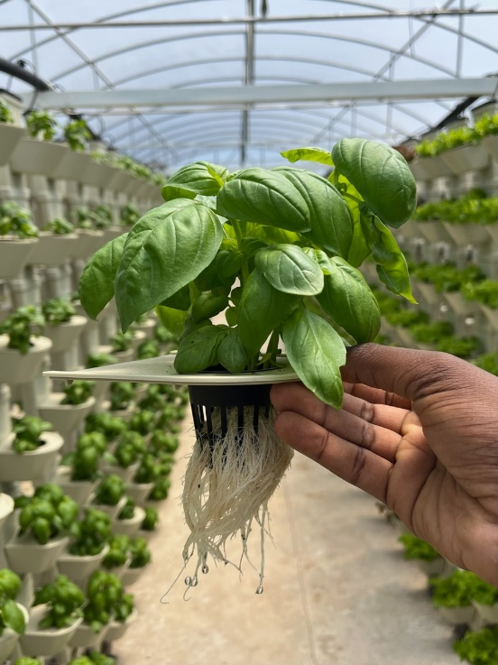
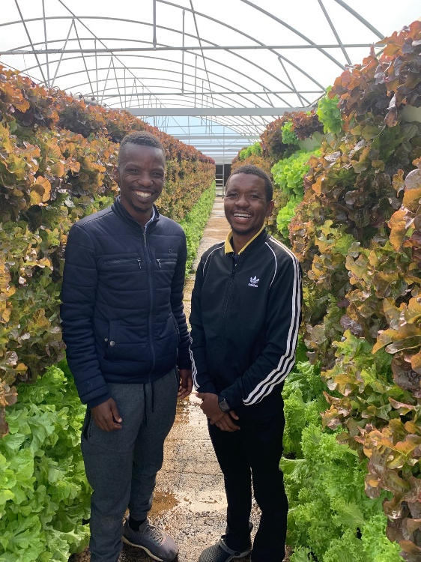
WADER: HYDROPONIC PLANTER- FOOD SECURITY
The hydroponic planter is designed to allow the plant to have access to water and minerals at anytime of the day. The system caters for water and nutrient supply also in times of power shortages, pump failure or any other reasons. The design essentially allows for plants to be irrigated periodically, as opposed to continuous supply, thus reducing the amount of energy required per kg produced and water wastage. The system allows for decentralized farming.
Technology Area
Water Efficiency, Energy Efficiency,
Land use Efficiency
RDI Cluster
Productive Use of Water
Impact
Enterprise Development, Capacity development
91st MEETING OF THE SCIENTIFIC AND TECHNICAL COUNCIL OF THE
AFRICAN WATER AND SANITATION ASSOCIATION
From AfWA to AfWASA: “What governance and management structures
are required to boost water and sanitation performance in Africa”
3-5 July 2023

Slide 11
SASTEP: SANITATION TECHNOLOGY ACCELERATOR
SOUTH AFRICAN SANITATION TECHNOLOGY ENTERPRISE PROGRAMME
Non-sewered systems (Reinventing the toilet)
  Appliance design for households
  Modular systems for household, communal and commercial spaces
  Convenience of a flush
  Resource efficient toilets and toilet systems
  Systems designed for circularity (Full recycle membrane systems (water), and Sludge valorization systems)
  Cost (Understand cradle to grave cost (Lifecycle cost)
91st MEETING OF THE SCIENTIFIC AND TECHNICAL COUNCIL OF THE
AFRICAN WATER AND SANITATION ASSOCIATION
From AfWA to AfWASA: “What governance and management structures
are required to boost water and sanitation performance in Africa”
3-5 July 2023

Slide 12
SASTEP: SANITATION TECHNOLOGY ACCELERATOR
SOUTH AFRICAN SANITATION TECHNOLOGY ENTERPRISE PROGRAMME
Non-sewered systems (Reinventing the toilet)
  Appliance design for households
  Modular systems for household, communal and commercial spaces
  Convenience of a flush
  Resource efficient toilets and toilet systems
  Systems designed for circularity (Full recycle membrane systems (water), and Sludge valorization systems)
  Cost (Understand cradle to grave cost (Lifecycle cost)
91st MEETING OF THE SCIENTIFIC AND TECHNICAL COUNCIL OF THE
AFRICAN WATER AND SANITATION ASSOCIATION
From AfWA to AfWASA: “What governance and management structures
are required to boost water and sanitation performance in Africa”
3-5 July 2023

Slide 13
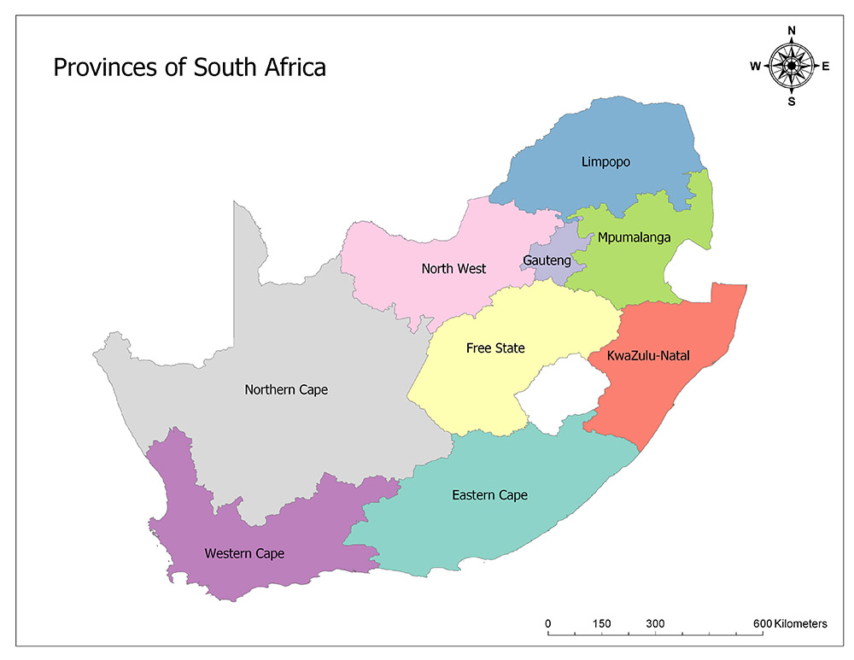
SASTEP: SCHOOLS SANITATION
Department of Education provided 10 schools across 3 provinces to pilot and demonstrate innovative sanitation technologies.
7 demo sites operational and 3 in planning & implementation phase (in EC).
We evaluating the technologies to collect data on:
  Technology performance
  Benchmark Cost
  User acceptance
  Gender Intentionality
  Standards Readiness
  Climate
3
1
6
10 Schools across
3 provinces
91st MEETING OF THE SCIENTIFIC AND TECHNICAL COUNCIL OF THE
AFRICAN WATER AND SANITATION ASSOCIATION
From AfWA to AfWASA: “What governance and management structures
are required to boost water and sanitation performance in Africa”
3-5 July 2023

Slide 14
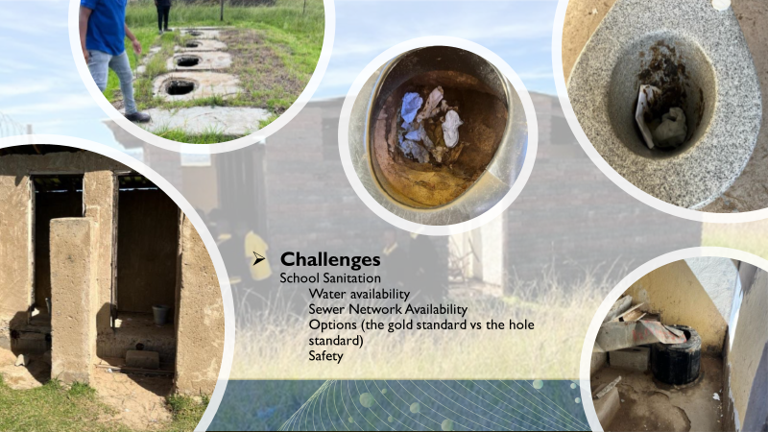
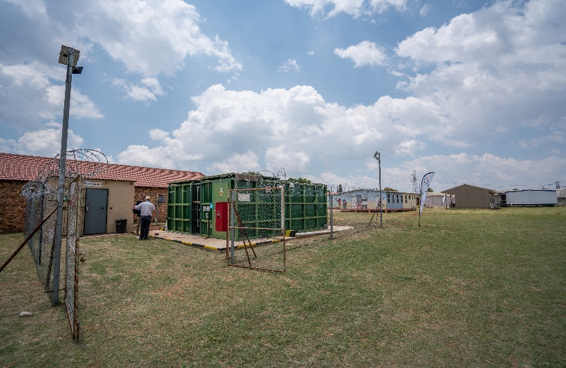
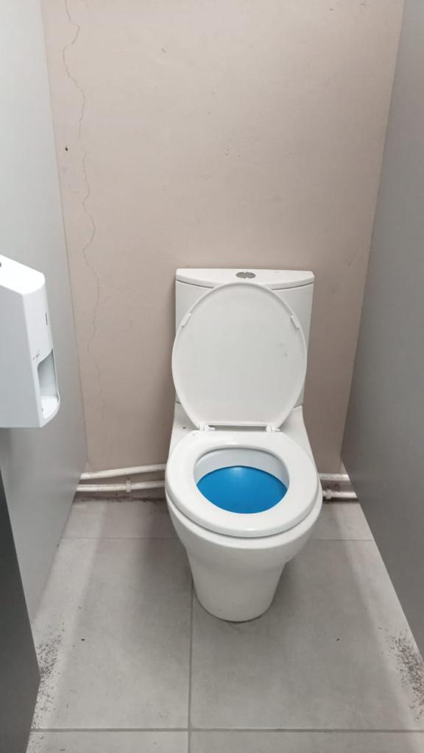
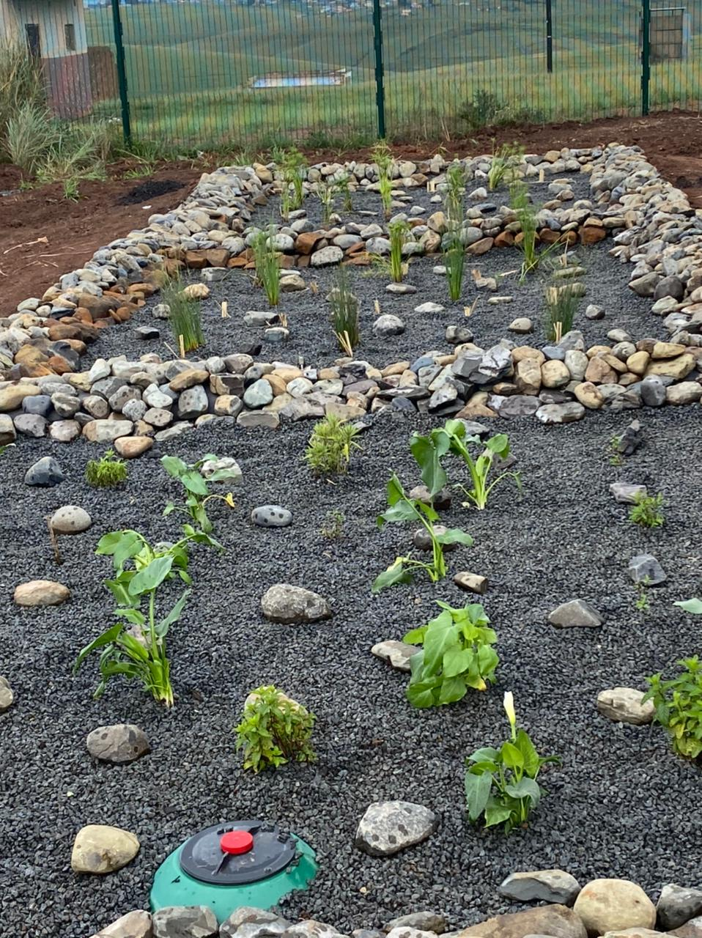
SASTEP: DEMONSTRATING OVER 8 DIFFERENT TECHNOLOGIES
91st MEETING OF THE SCIENTIFIC AND TECHNICAL COUNCIL OF THE
AFRICAN WATER AND SANITATION ASSOCIATION
From AfWA to AfWASA: “What governance and management structures
are required to boost water and sanitation performance in Africa”
3-5 July 2023

Slide 15
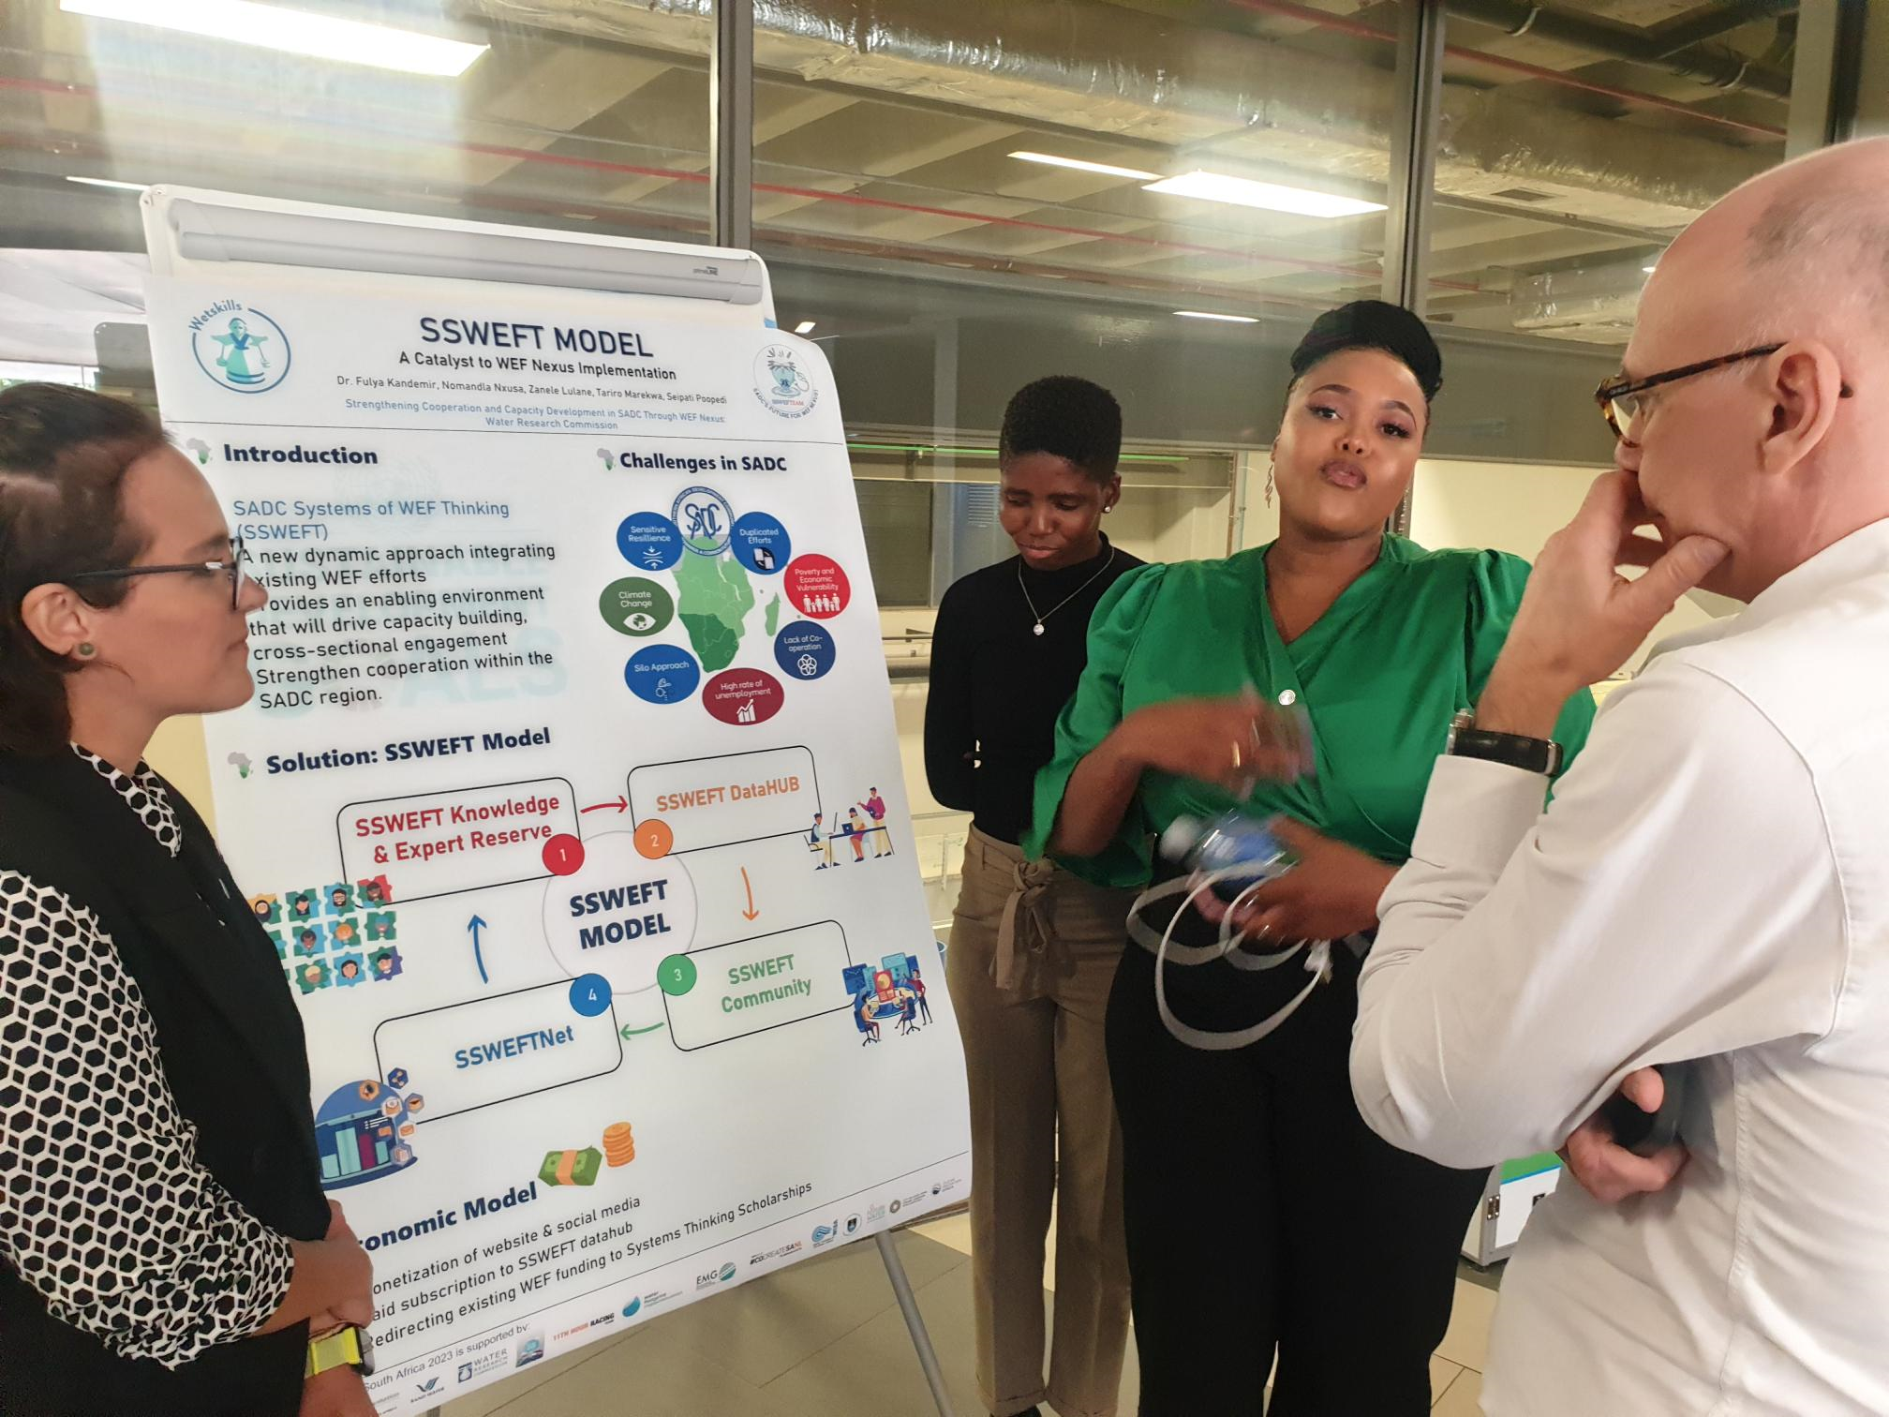
CAPACITY BUILDING
Building programmes for Researchers
  Accelerator Programme for graduates
  Hubs
  Datacentre
  CoE’s
Training for specific research products
Youth Programmes
Collaborative Programmes (Partnership):
  WETSKILLS (SADC – WEF SKILLS)
  Young Engineers Changemaker Programme
  Water Fellows Post-graduate
Innovations
  Enterprise Development
  Grassroots innovators (higher risk/developmental)
91st MEETING OF THE SCIENTIFIC AND TECHNICAL COUNCIL OF THE
AFRICAN WATER AND SANITATION ASSOCIATION
From AfWA to AfWASA: “What governance and management structures
are required to boost water and sanitation performance in Africa”
3-5 July 2023

Slide 16
TAKE HOME MESSAGES
Build strong relationships and stakeholder maps
Understand the socio-technical systems RDI are implemented in:
  Policy
  Norms and standards
  Economics and procurement
  Product and service standards
Invest in de-risking technologies by allowing for testing
Develop testbed partnerships
Demonstrate in multiple environments (testbeds)
Build processes and programmes that support young researchers, graduates, commercial partners, entrepreneurs and innovators
Drive collaborative spaces – not competitive ones
91st MEETING OF THE SCIENTIFIC AND TECHNICAL COUNCIL OF THE
AFRICAN WATER AND SANITATION ASSOCIATION
From AfWA to AfWASA: “What governance and management structures
are required to boost water and sanitation performance in Africa”
3-5 July 2023

Slide 17
Thank you
valerien@wrc.org.za

